Slide 1
The Communication Process

Slide 2
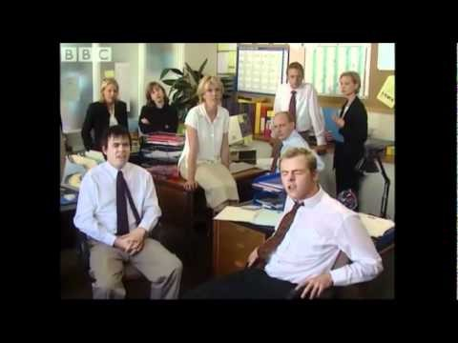

Slide 3


Goals
Describe the communication process
Understand Formal Communication Flow (directional flow)
Describe barriers to effective communication

Slide 4
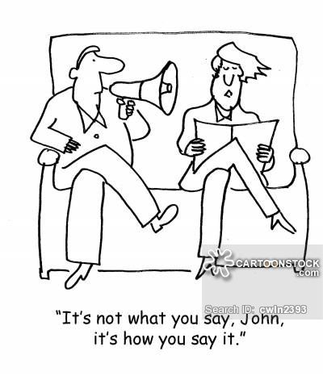
communicate
Because we communicate something to someone in some form every day, every minute, every hour, we can control what we say and how we say it, but not always how it is perceived

Slide 5

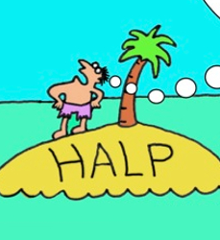
What is communication
Communication: the process by which information is exchanged between individuals through symbols, signs, or behaviors
It is when you express:
 an Opinion
 an Impression
 a Comment
 a Judgment
 a Bias
Add this to the definition from the video on top of page 1.

Slide 6
How Businesses communicate
What’s the Difference?
One-to-one
One-to-many
Many-to-one
Many-to-Many
Communicate
Communicating
Communication
Communications

Slide 7
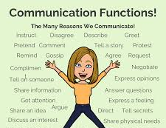
Why Businesses communicate
Purposes (endless)
Most common
Inform
Instruct
Influence
But Also
Make decisions
Promote Understanding
Resolve Issues

Slide 8
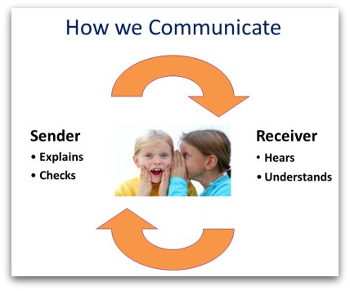
Communication Process
Sender
individual who initiates a message
The sender might be a - speaker, a writer, or someone who merely gestures.
Receiver
the individual, or the group of individuals to whom a message is directed.
The receiver might be the listener, reader, or observer
The receiver is also called the "audience" or decoder.

Slide 9
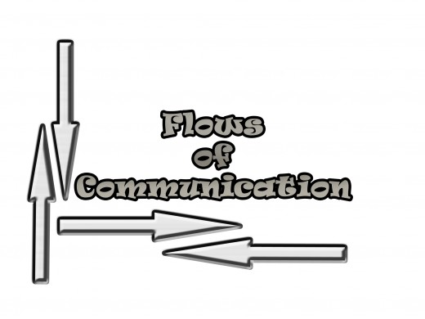
Communication Flows
CEO
Managers
Line Staff
Line Staff
Managers
Supervisors
Vice Presidents
Supervisors
Line Staff
Line Staff
HR
Formal Communication network – system of official channels that carry organizational messages that can be upward, downward or lateral.

Slide 10
Three Flows of Formal Communication
Downward Communication – flow that originates with leaders/supervisors and are passed down to employees
Upward communication – flows that come from lower and move to upper organization levels
Lateral-Diagonal Flows – flows between individuals of the same positions in the same department or across different departments (ex: manager to manager)

Slide 11
Which Direction is it?
In groups at your table, discuss the following work-related issues/topics. Decide which direction this type of information generally would flow: Upward, Downward, or Lateral
assignments
Attitude issues
Clarifications
Coordinated efforts brainstorming share ideas
Directives
Goals
Ideas
Policies
Problem solving
Problems on the job
Procedures
Share Accomplishments
Staff advice

Slide 12
Your Answers:
Downward: Upward: Lateral

Slide 14
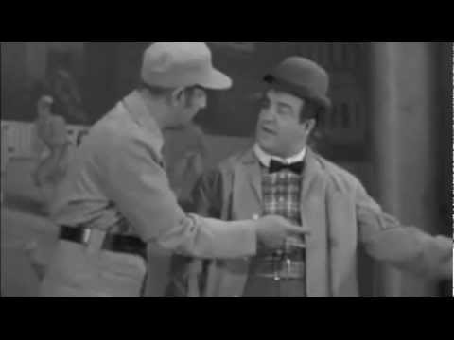

control what we say and how we say it, but not always how it is perceived

Slide 15
Barriers to Communication Day 2

Slide 16
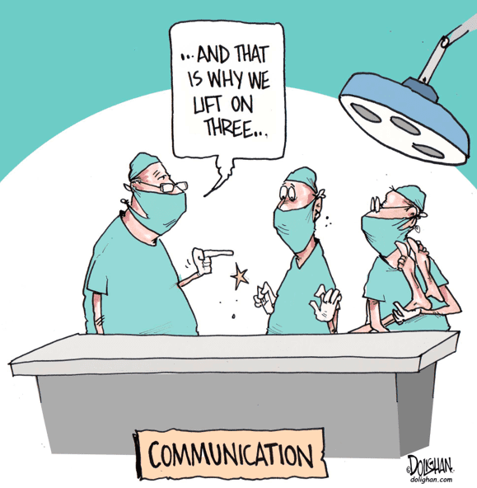
Communication Barriers
Distraction –Anything that interferes with the sender’s creating and delivering a message and the receiver’s getting and interpreting a message
Called noise
Ex: ringing phones, emails, text messages, grammar errors, others talking, loud noises
Students talking while the instructor is talking
Some cope by scheduling time to answer calls, write messages etc.

Slide 17
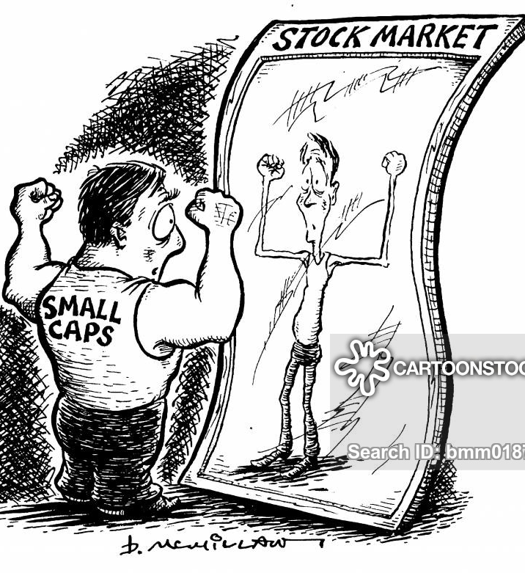
Communication Barriers
Distortion - How people change messages, consciously or unconsciously
Unconsciously pass along only the information they feel others need, leaving out important information

Slide 18

Common Barriers
Physical Barriers – poor equipment
Attitudes – emotions (anger, nervous, need to win)
Language – Slang and professional jargon from different generations
Cultural Noise – stereotypes
Information Overload – too much info - takes time to absorb information
Jumping to conclusions – listen to all the facts

Slide 19
Broken Telephone Game
Notes:
If you are planning for a year, sow rice; if you are planning for a decade, plant trees; if you are planning for a lifetime, educate people
Fake news executives are nicer than real news executives, though real news executives are funnier than fake news executives. They don't know they're being funny.
I’d love eating toasted cheese and tuna sandwiches.
The quick brown fox jumps over the lazy dog and says hello to the cat.
The angry birds ate candy and crushed the subway surfer.
A pink pig and a pesky donkey flew a kite at night.
Rabbits rumble, giants grumble, dogs bark in the dark, and wolves woo in the blue.
Wednesday is the hump day, but is the camel happy about it.
Alex the Alsatian ate eleven Éclairs in the evening with an Espresso.
The Martians invested in shares when the NASDAQ dropped several feet.
Roger racketed seventeen balls against Sylvester alone.
Bob the builder rented Oswald’s apartment and borrowed Noddy’s car.

Slide 20
In Google Classroom – Open The Text to a Friend
1. Your friend wins an award at work for employee of the month. Write a quick text to your friend to congratulate him/her

Slide 21
In Google Classroom – Open The Text From the Boss
Now think like a boss. How would you respond to this:
Your employee wins an award at work for employee of the month. Write a quick text to to congratulate him/her

Slide 22
Construct an Information Email – Negative behavior Google Classroom
1, You hear a friend call a second friend a rude and disrespectful name. It was not said in a mean way but in a joking manner. However, it made you uncomfortable, and frankly mad. Write a quick note to your fried that you would email or text them to inform them not to do that?

Slide 23
Construct an Information Email – Negative behavior Google Classroom
Now same scenario, except you are the supervisor and it was one employee to another. You are a supervisor of both people and you write a quick email about informing the employee it should not be done. What would you write?
Scenario: You hear an employee call a second friend a rude and disrespectful name. It was not said in a mean way but in a joking manner. However, it made you uncomfortable, and frankly mad. Write a quick note that you would email or text them to inform them not to do that.

Slide 24
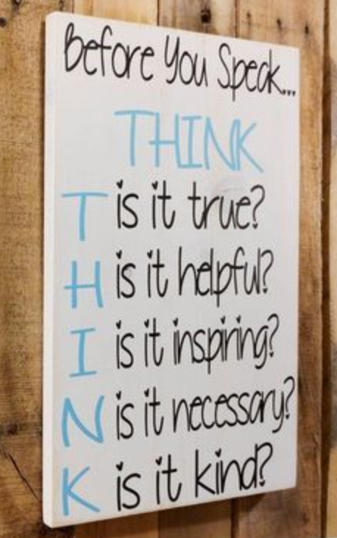
https://ejoy-english.com/blog/how-to-write-an-email-to-inform-something/

